Slide 1
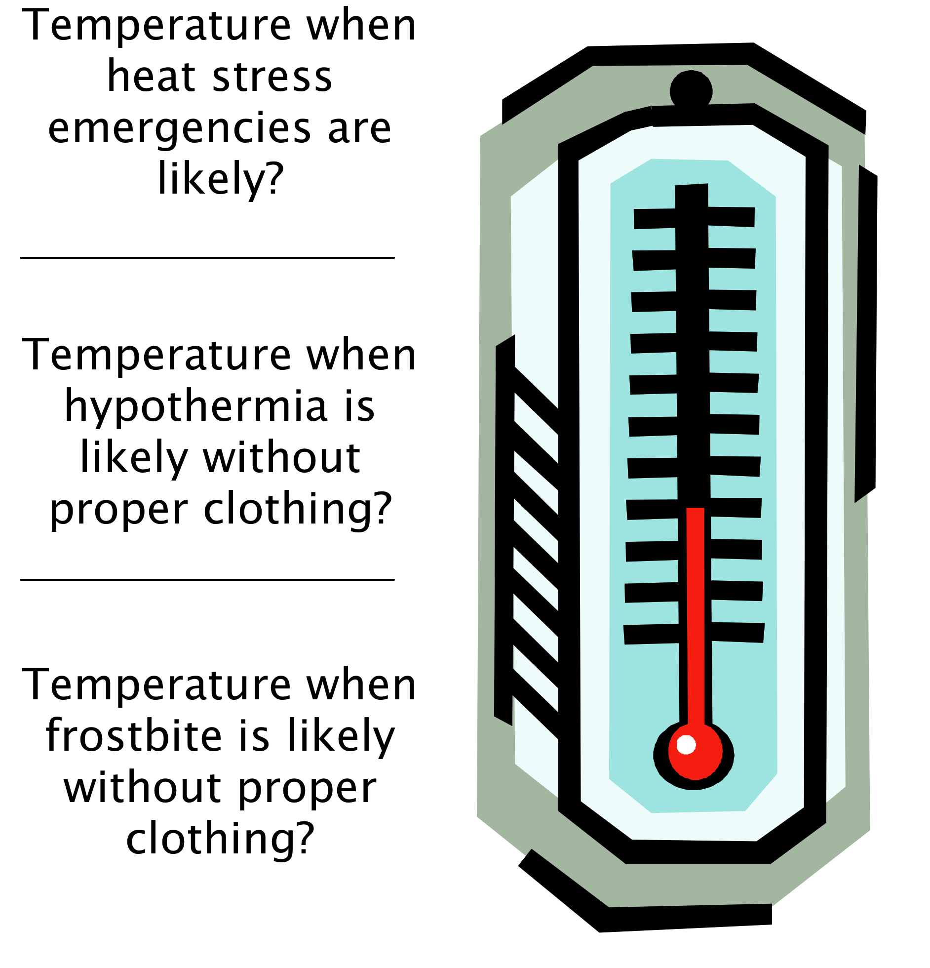
Too Hot? Too Cold?

Slide 2
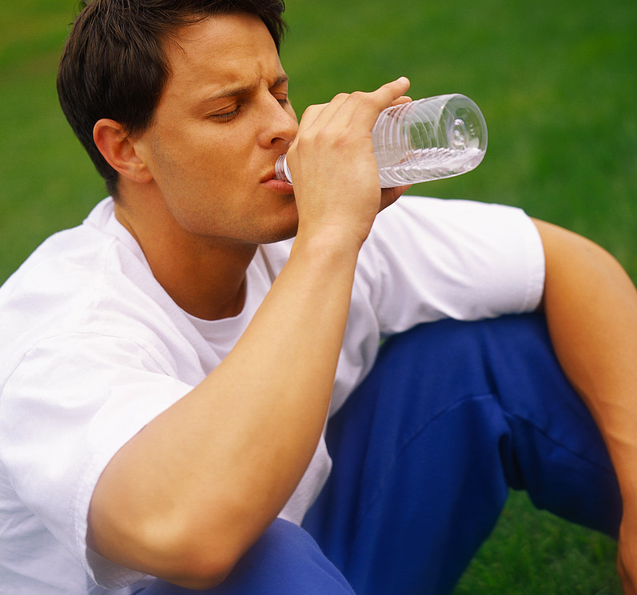
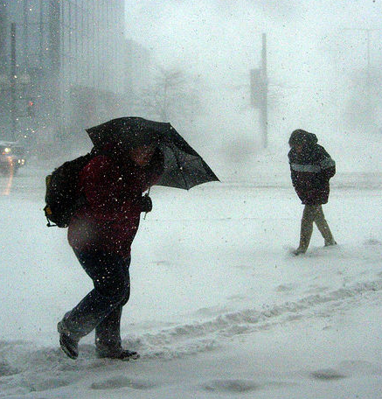
Preventing
Climate-Related Injuries

Slide 3
How Quickly Hypothermia Happens
Survival Times in Cold Water Without Protective Clothing
Water Temperature Loss of Dexterity Exhaustion or Expected Time of
Degrees F with no protective clothing Unconsciousness Survival
32.5 Under 2 min. Under 15 min. Under 15 to 45 min.
32.5 - 40 Under 3 min. 15 to 30 min. 30 to 90 min.
40 - 50 Under 5 min. 30 to 60 min. 1 to 3 hrs.
50 - 60 10 to 15 min. 1 to 2 hrs. 1 to 6 hrs.
60 - 70 30 to 40 min. 2 to 7 hrs. 2 to 40 hrs.
70 - 80 1 to 2 hrs. 2 to 12 hrs. 3 hrs. to indefinite Over 80 2 to 12 hrs. Indefinite Indefinite
Adapted from Local Knowledge—A Skipper’s Reference by Kevin Monahan

Slide 4
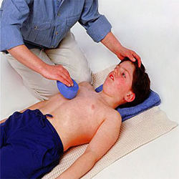
Heat Exhaustion,
Heat Cramps, Heat Stroke

Slide 5
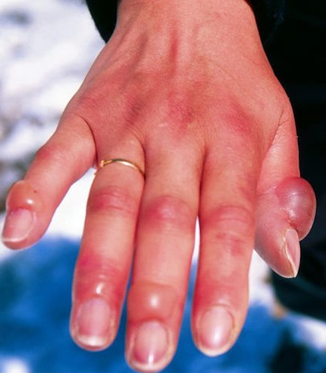
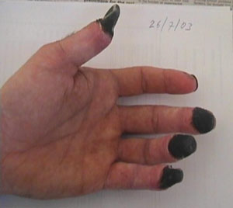
Frostbite

Slide 6
Hypothermia

